Slide 1
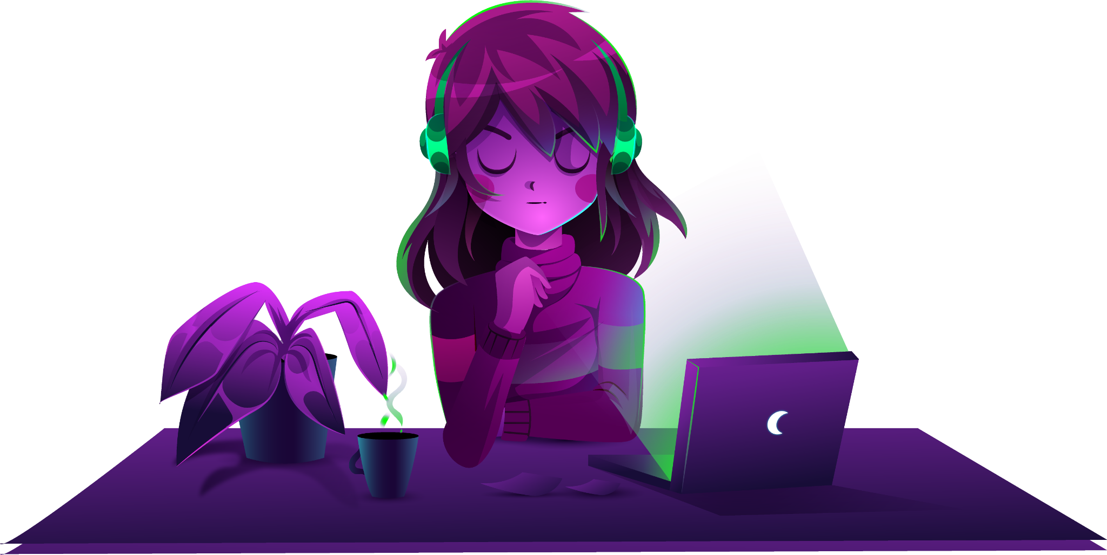
Anime Merch
Prepared By: Devam Pathak
Roll No. : 07
Branch: IT
Division : F1
Enroll. No. : 22002170220027
Sub : FSD

Slide 2
Table of contents
Why this web-site?
What is Anime Merch?
Recently the craze of anime and anime merches is getting bigger and bigger..
Due to it ability to show the emotions in an animation which hard to get right.
It is an E commerse web site to sell
Anime Figures, T-shirts, Katanas And Mini katana

Slide 3
Functionalities
First opens the Index page.
From there you can navigate through whole web-site using navbar.
Navbar will have following buttons:
Figures.
T-Shirts
Swords

Slide 4
About!
Merits
De-Merits
Future Development
User Friendly GUI.
Easy to navigate
Almost all anime merch at same web-site
Lacks The data base.
No Payment Gatesways
Limited Merches
Adding the Database to store the interactions
Add Payment gateways

Slide 5
Thanks!

